Slide 1
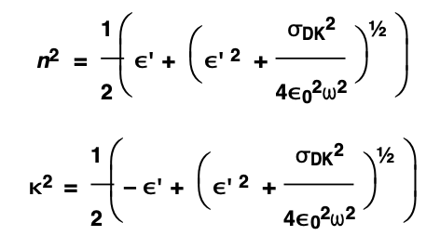
Results
Real refractive index (n) = sqrt(Relative permittivity) = 1.59 - 1.61
ε’ = Relative permittivity
ε 0 = 8.85×10⁻¹² F⋅m⁻¹
w = 2*pi*f

Slide 2
Thin:

Slide 3
Thin

Slide 4
Thick:

Slide 5
Thick

